Slide 1
Memory Management

Slide 2
Chapter Objectives
To provide a detailed description of various ways of organizing memory hardware.
To discuss various memory-management techniques, including paging and segmentation.

Slide 3
Background
Program must be brought into memory and placed within a process for it to be run
Input queue – collection of processes on the disk that are waiting to be brought into memory to run the program
User programs go through several steps before being run

Slide 4
Memory Management
Subdividing memory to accommodate multiple processes
Memory needs to be allocated to ensure a reasonable supply of ready processes to consume available processor time

Slide 5
Memory Management Requirements
Relocation
Protection
Sharing
Logical Organization
Physical Organization

Slide 6
Memory Management Requirements
Relocation
  Programmer does not know where the program will be placed in memory when it is executed
  While the program is executing, it may be swapped to disk and returned to main memory at a different location (relocated)
  Memory references must be translated in the code to actual physical memory address

Slide 7
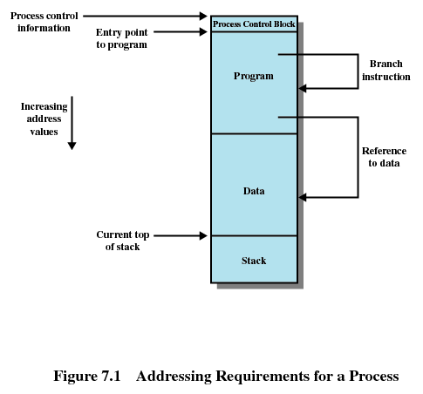
P1
P2

Slide 8
Memory Management Requirements
Protection
  Processes should not be able to reference memory locations in another process without permission
  Impossible to check absolute addresses at compile time
  Must be checked at rum time
  Memory protection requirement must be satisfied by the processor (hardware) rather than the operating system (software)
    Operating system cannot anticipate all of the memory references a program will make

Slide 9
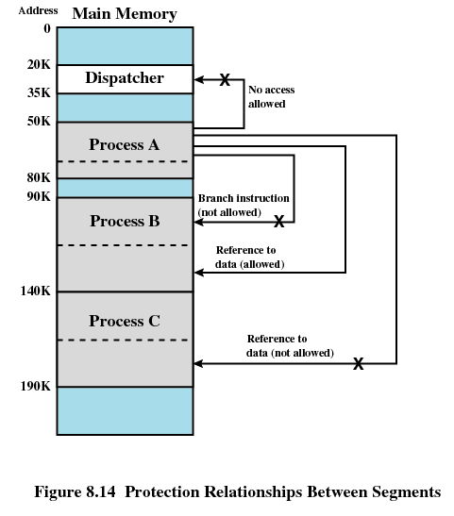

Slide 10
Memory Management Requirements
Sharing
  Allow several processes to access the same portion of memory
  Better to allow each process access to the same copy of the program rather than have their own separate copy

Slide 11
Memory Management Requirements
Logical Organization
  Programs are written in modules
  Modules can be written and compiled independently
  Different degrees of protection given to modules (read-only, execute-only)
  Share modules among processes

Slide 12
Memory Management Requirements
Physical Organization
  Memory available for a program plus its data may be insufficient
    Overlaying allows various modules to be assigned the same region of memory
  Programmer does not know how much space will be available

Slide 13
Memory Partitioning
Fixed partitioning
Dynamic partitioning

Slide 14
Fixed Partitioning
Equal-size partitions
Unequal-sized partitions

Slide 15
Fixed Partitioning
Equal-size partitions
  Any process whose size is less than or equal to the partition size can be loaded into an available partition
  If all partitions are full, the operating system can swap a process out of a partition
  A program may not fit in a partition. The programmer must design the program with overlays

Slide 16
Fixed Partitioning
Main memory use is inefficient. Any program, no matter how small, occupies an entire partition. This is called internal fragmentation.
E.g: A program of size 2MB occupies an 8MB partition → wasted space internal to a partition, as the data loaded is smaller than the partition size.

Slide 17
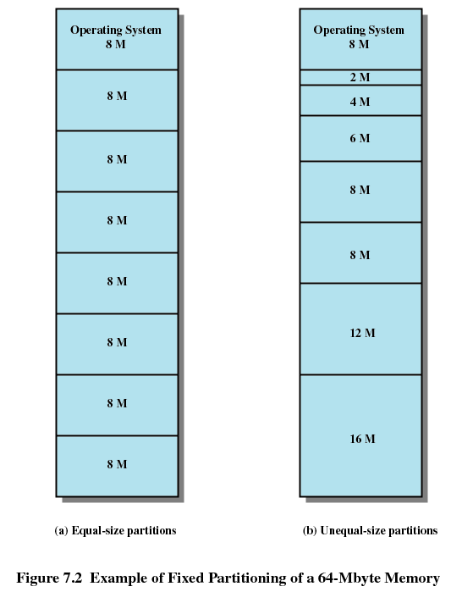

Slide 18
Placement Algorithm with Partitions
Equal-size partitions
  Because all partitions are of equal size, it does not matter which partition is used
Unequal-size partitions (also fixed)
  Can assign each process to the smallest partition within which it will fit
  Queue for each partition
  Processes are assigned in such a way as to minimize wasted memory within a partition

Slide 19
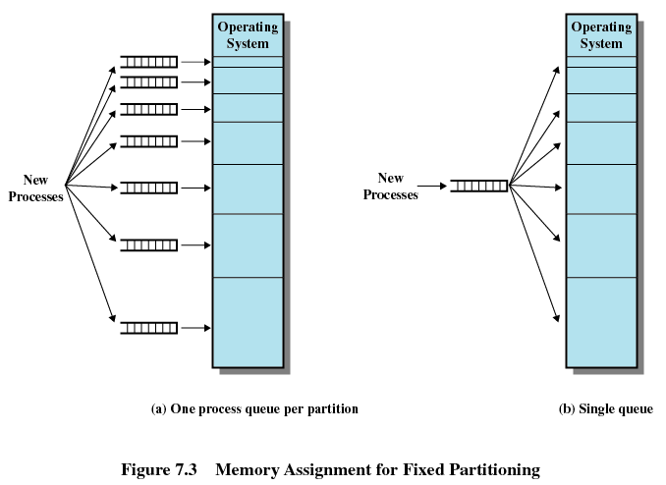

Slide 20
Dynamic Partitioning
Partitions are of variable length and number
Process is allocated exactly as much memory as required
Eventually get holes in the memory. This is called external fragmentation
Must use compaction to shift processes so they are contiguous and all free memory is in one block

Slide 21
Contiguous Allocation
Hole – block of available memory; holes of various size are scattered throughout memory
When a process arrives, it is allocated memory from a hole large enough to accommodate it
Operating system maintains information about:
a) allocated partitions b) free partitions (hole)
OS
OS
OS
OS
process 5
process 5
process 5
process 5
process 9
process 9
process 8
process 10
process 2
process 2
process 2
process 2

Slide 22
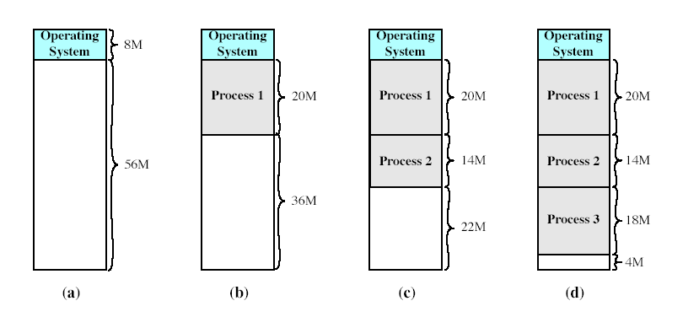

Slide 23
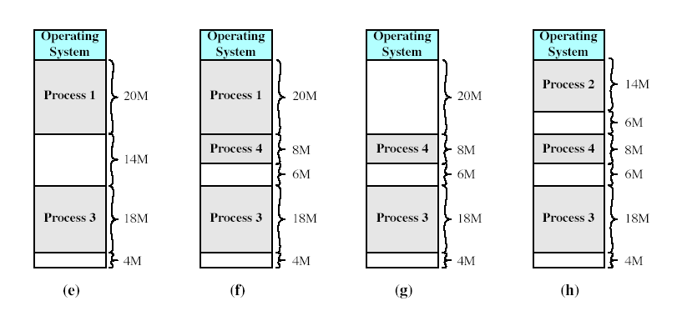

Slide 24
Dynamic Partitioning
Difficulty with compaction:
It is a time consuming procedure – wasteful of processor time.
Therefore, needs dynamic relocation capability, i.e. it must be possible to move a program from one region to another (in MM) without invalidating the memory references in the program.

Slide 25
Dynamic Partitioning Placement Algorithm
Operating system must decide which free block to allocate to a process
  Best-fit
  Worst-fit
  First-fit
  Next-fit
First-fit and best-fit better than worst-fit in terms of speed and storage utilization

Slide 26
Best-fit algorithm
Allocate the smallest hole that is big enough; must search entire list, unless ordered by size. Produces the smallest leftover hole.
Chooses the block that is closest in size to the request
Worst performer overall
Since smallest block is found for process, the smallest amount of fragmentation is left
Memory compaction must be done more often

Slide 27
Worst-fit algorithm
Allocate the largest hole; must also search entire list.
Produces the largest leftover hole. Worst performer overall

Slide 28
First-fit algorithm
Allocate the first hole that is big enough
Scans memory form the beginning and chooses the first available block that is large enough
Fastest
May have many process loaded in the front end of memory that must be searched over when trying to find a free block

Slide 29
Next-fit
Scans memory from the location of the last placement
More often allocate a block of memory at the end of memory where the largest block is found
The largest block of memory is broken up into smaller blocks
Compaction is required to obtain a large block at the end of memory

Slide 30
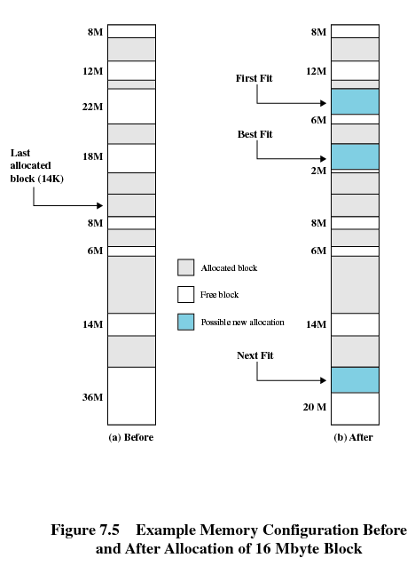
Last
allocated
block (14M)
To allocate 16M Block

Slide 31
Example
40K |  |  | 80K | 30K |  |  | 50K |  |  |  | 30K
10K
20K
20K
20K
10K
10K
20K
The shaded areas are allocated blocks; the white areas are free blocks.
The next FOUR memory requests are 20K, 50K, 10K and 30K (loaded in that order).
Using the following placement algorithms, show the partition allocated for the requests.
  First-fit
  Best-fit
  Next-fit

Slide 32
Example: First-fit
40K |  |  | 80K | 30K |  |  | 50K |  |  |  | 30K
20
10K
20K
20K
20K
10K
10K
20K
20K, 50K, 10K and 30K (in that order).
  Allocate for 20K

Slide 33
Example: First-fit
40K |  |  | 80K | 30K |  |  | 50K |  |  |  | 30K
20
50
10K
20K
20K
20K
10K
10K
20K
20K, 50K, 10K and 30K (in that order).
  Allocate for 20K
  Allocate for 50K

Slide 34
Example: First-fit
10
40K |  |  | 80K | 30K |  |  | 50K |  |  |  | 30K
20
50
10K
20K
20K
20K
10K
10K
20K
20K, 50K, 10K and 30K (in that order).
  Allocate for 20K
  Allocate for 50K
  Allocate for 10K

Slide 35
Example: First-fit
10
30
40K |  |  | 80K | 30K |  |  | 50K |  |  |  | 30K
20
50
10K
20K
20K
20K
10K
10K
20K
20K, 50K, 10K and 30K (in that order).
  Allocate for 20K
  Allocate for 50K
  Allocate for 10K
  Allocate for 30K

Slide 36
Example: Best-fit
40K |  |  | 80K | 30K |  |  | 50K |  |  |  | 30K
10K
20K
20K
20K
10K
10K
20K
20K, 50K, 10K and 30K (in that order).

Slide 37
Example: Best-fit
40K |  |  | 80K | 30K |  |  | 50K |  |  |  | 30K
20
10K
20K
20K
20K
10K
10K
20K
20K, 50K, 10K and 30K (in that order).
  Allocate for 20K

Slide 38
Example: Best-fit
40K |  |  | 80K | 30K |  |  | 50K |  |  |  | 30K
20
50
10K
20K
20K
20K
10K
10K
20K
20K, 50K, 10K and 30K (in that order).
  Allocate for 20K
  Allocate for 50K

Slide 39
Example: Best-fit
10
40K |  |  | 80K | 30K |  |  | 50K |  |  |  | 30K
20
50
10K
20K
20K
20K
10K
10K
20K
20K, 50K, 10K and 30K (in that order).
  Allocate for 20K
  Allocate for 50K
  Allocate for 10K

Slide 40
Example: Best-fit
10
30
40K |  |  | 80K | 30K |  |  | 50K |  |  |  | 30K
20
50
10K
20K
20K
20K
10K
10K
20K
20K, 50K, 10K and 30K (in that order).
  Allocate for 20K
  Allocate for 50K
  Allocate for 10K
  Allocate for 30K

Slide 41
Example: Next-fit
40K |  |  | 80K | 30K |  |  | 50K |  |  |  | 30K
10K
20K
20K
20K
10K
10K
20K
most recently added block
20K, 50K, 10K and 30K (in that order).

Slide 42
Example: Next-fit
40K |  |  | 80K | 30K |  |  | 50K |  |  |  | 30K
20
10K
20K
20K
20K
10K
10K
20K
most recently added block
20K, 50K, 10K and 30K (in that order).
  Allocate for 20K

Slide 43
Example: Next-fit
40K |  |  | 80K | 30K |  |  | 50K |  |  |  | 30K
20
50
10K
20K
20K
20K
10K
10K
20K
most recently added block
20K, 50K, 10K and 30K (in that order).
  Allocate for 20K
  Allocate for 50K

Slide 44
Example: Next-fit
50
10
40K |  |  | 80K | 30K |  |  | 50K |  |  |  | 30K
20
10K
20K
20K
20K
10K
10K
20K
most recently added block
20K, 50K, 10K and 30K (in that order).
  Allocate for 20K
  Allocate for 50K
  Allocate for 10K

Slide 45
Example: Next-fit
50
10
40K |  |  | 80K | 30K |  |  | 50K |  |  |  | 30K
20
30
10K
20K
20K
20K
10K
10K
20K
most recently added block
20K, 50K, 10K and 30K (in that order).
  Allocate for 20K
  Allocate for 50K
  Allocate for 10K
  Allocate for 30K

Slide 46
Buddy System
Entire space available is treated as a single block of 2^{U}
If a request of size s such that 2^{U-1} < s <= 2^{U}, entire block is allocated
  Otherwise block is split into two equal buddies
  Process continues until smallest block greater than or equal to s is generated

Slide 47
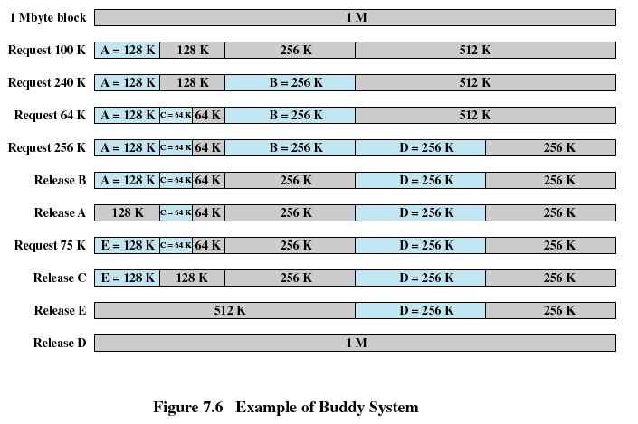

Slide 48
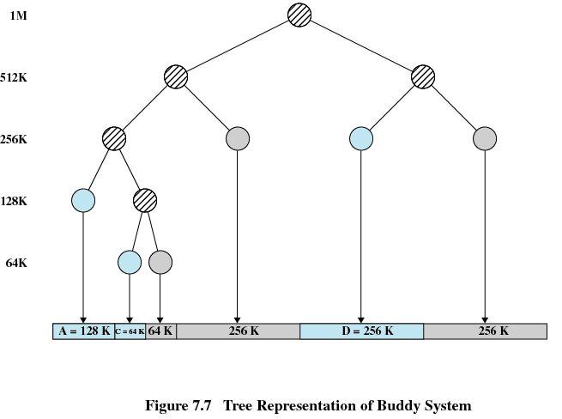

Slide 49
Relocation
When program loaded into memory the actual (absolute) memory locations are determined
A process may occupy different partitions which means different absolute memory locations during execution (from swapping)
Compaction will also cause a program to occupy a different partition which means different absolute memory locations

Slide 50
Addresses
Logical
  Reference to a memory location independent of the current assignment of data to memory
  Translation must be made to the physical address
  Logical address – generated by the CPU; also referred to as virtual address
Relative
  Address expressed as a location relative to some known point
Physical
  The absolute address or actual location in main memory
  Physical address – address seen by the memory unit

Slide 51
Memory-Management Unit (MMU)
Hardware device that maps virtual to physical address
In MMU scheme, the value in the relocation register is added to every address generated by a user process at the time it is sent to memory
The user program deals with logical addresses; it never sees the real physical addresses

Slide 52

Dynamic relocation using a relocation register

Slide 53
Registers Used during Execution
Base register
  Starting address for the process
Bounds/limit register
  Ending location of the process
These values are set when the process is loaded or when the process is swapped in

Slide 54
Registers Used during Execution
The value of the base register is added to a relative address to produce an absolute address
The resulting address is compared with the value in the bounds register
If the address is not within bounds, an interrupt is generated to the operating system

Slide 55
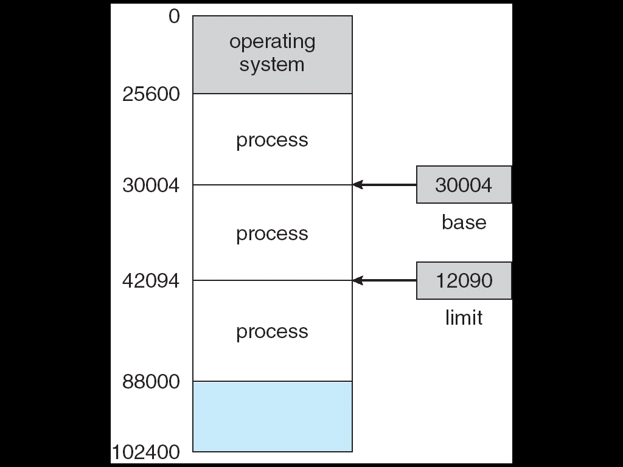
A base and a limit register define
a logical address space

Slide 56
Paging
Partition memory into small equal fixed-size chunks and divide each process into the same size chunks
The chunks of a process are called pages and chunks of memory are called frames
Operating system maintains a page table for each process
  Contains the frame location for each page in the process
  Memory address consist of a page number and offset within the page

Slide 57
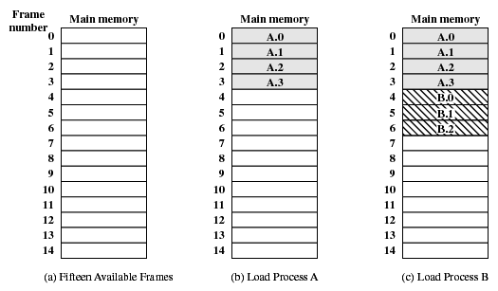
Assignment of Process Pages to Free Frames

Slide 58
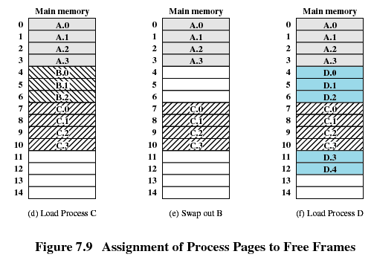
Assignment of Process Pages to Free Frames

Slide 59
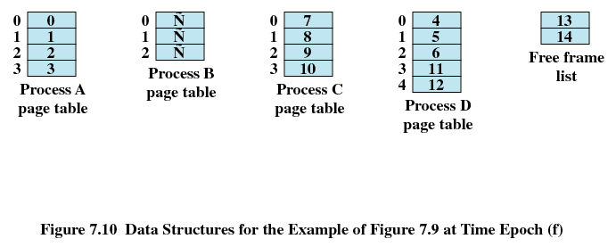
Page Tables for Example

Slide 60

Paging Example
Page #
Frame #

Slide 61
Paging Example
Page #
Frame #

Slide 62

Paging Example
Page #
Frame #
Page size = 4 bytes
Physical memory = 32 bytes
=> 32/4 = 8 partitions

Slide 63
Paging Example
Page 0
Page 1
Page 2
Page 3
Page #
Frame #
Frame 0
Frame 1
Frame 2
Frame 3
Frame 4
Frame 5
Frame 6
Frame 7
Physical = frame # x Page size + Page offset
address
Page size = 4 bytes
Physical memory = 32 bytes
=> 32/4 = 8 partitions

Slide 64

Free Frames
Before allocation
After allocation

Slide 65
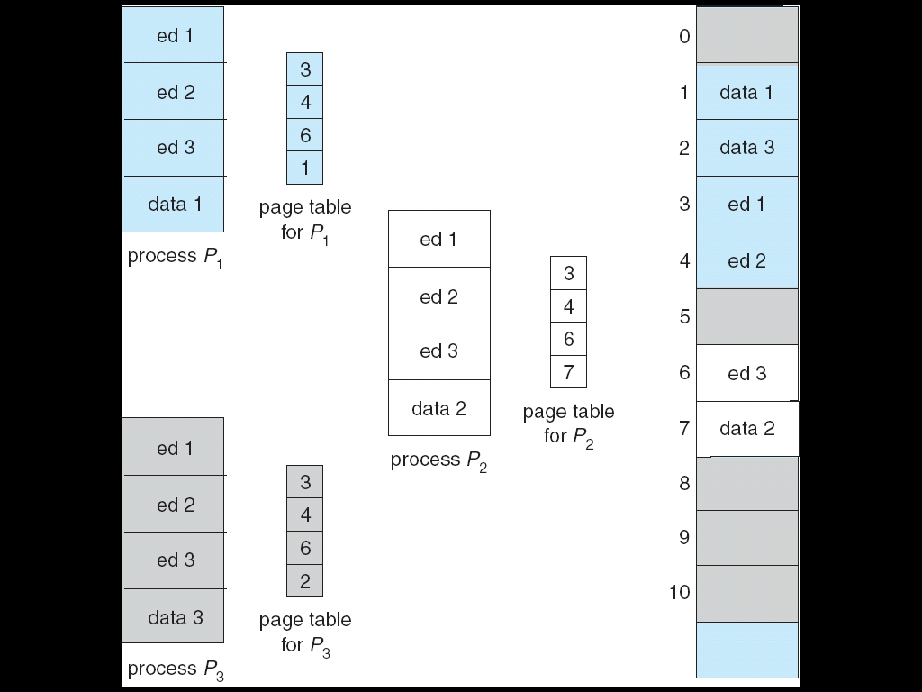
Shared Pages Example

Slide 66
Shared Pages Example

Slide 67
Segmentation
Memory-management scheme that supports user view of memory
A program is a collection of segments. A segment is a logical unit such as:
main program,
procedure,
function,
method,
object,
arrays
local variables,
global variables,
common block,
stack,
symbol table,

Slide 68

User’s View of a Program

Slide 69
Logical View of Segmentation
1
1
4
2
3
4
2
3
user space
physical memory space

Slide 70

Example of Segmentation

Slide 71
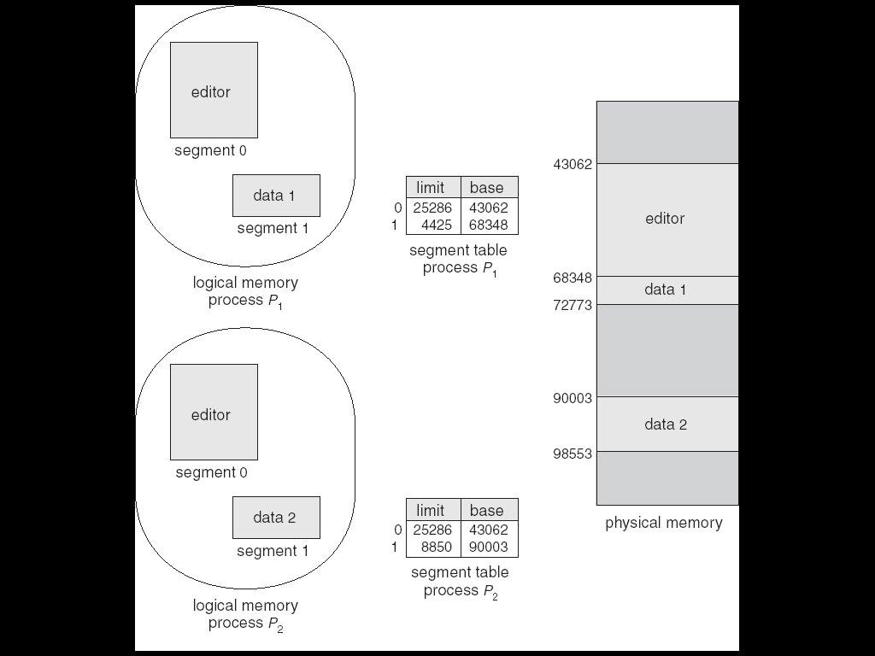
Sharing of Segments

Slide 72
Segmentation
All segments of all programs do not have to be of the same length
There is a maximum segment length
Addressing consist of two parts - a segment number and an offset
Since segments are not equal, segmentation is similar to dynamic partitioning

Slide 73
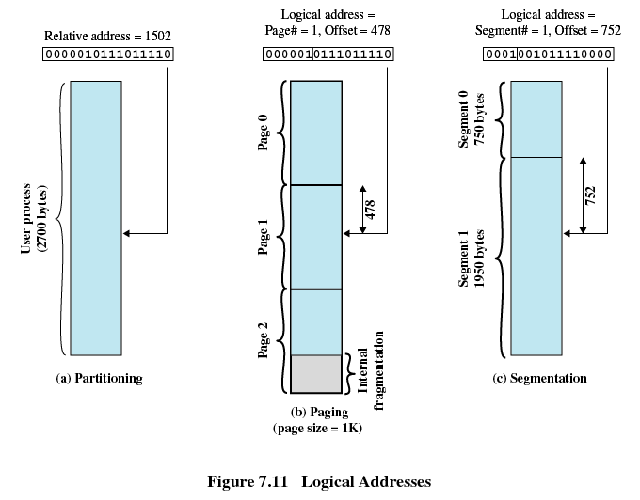

Slide 74
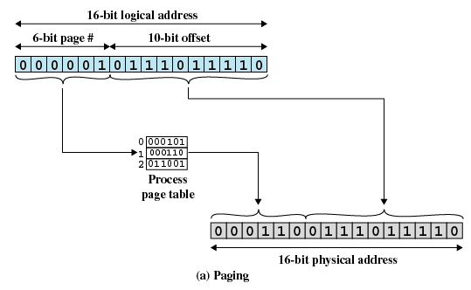

Slide 75
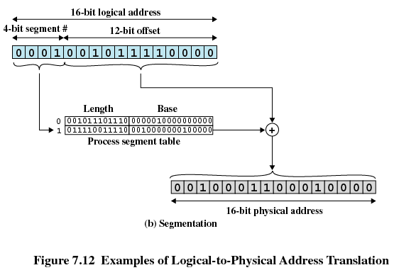

Slide 76

MULTICS Address Translation Scheme

Slide 77
Segmentation with Paging – Intel 386
As shown in the following diagram, the Intel 386 uses segmentation with paging for memory management with a two-level paging scheme

Slide 78

Intel 30386 Address Translation

Slide 79
Linux on Intel 80x86
Uses minimal segmentation to keep memory management implementation more portable
Uses 6 segments:
  Kernel code
  Kernel data
  User code (shared by all user processes, using logical addresses)
  User data (likewise shared)
  Task-state (per-process hardware context)
  LDT
Uses 2 protection levels:
  Kernel mode
  User mode

